Slide 1

It Takes All Kinds
Appreciating our differences while recognizing our similarities

Slide 2
Using DiSC Profiles

Slide 3
The DiSC Profile
The DiSC Profile is a personality assessment (not test) that provides insights into natural and adaptable behavioral styles in relation to the workplace, leadership, project teams.
https://www.onlinediscprofile.com/what-is-disc/

Slide 4
D

Slide 5
Dominance
direct, results-oriented, firm, strong willed, and forceful
Tendencies: Needs Others Who:
Getting immediate results * Weigh pros and cons
Causing action * Calculate risks
Accepting challenges * Use caution
Taking authority * Research facts
Managing Trouble * Deliberate before deciding
Solving problems * Structure environment

Slide 6
High D’s Environment
Power and authority
Prestige and challenge
Opportunities for individual accomplishments
Wide scope of operations
Direct answers
Opportunities for advancement
Freedom from controls and supervision
Many new and varied activities

Slide 7
High D’s Action Plan To Be More Effective
Receive difficult assignments
Understand that they need people
Base techniques on practical experience
Receive an occasional shock
Identify with a group
Verbalize reasons for conclusions
Be aware of existing sanctions
Pace self and relax more

Slide 8
Influence
Outgoing, enthusiastic, optimistic, high-spirited, and lively
Tendencies: Needs Others Who:
Generating enthusiasm * Concentrate on tasks
Being articulate * Respect sincerity
Entertaining people * Take logical approach
Participating in a group * Prefer to deal with things instead of people

Slide 9
High i’s Environment
Popularity, social recognition
Public recognition of ability
Freedom of expression
Group activities outside of the job
Democratic relationships
Freedom from control and detail
Opportunities to verbalize proposals
Coaching and counseling

Slide 10
High i’s Action Plan To Be More Effective
Control time
Make objective decisions
Use hands-on management
Be more realistic appraising others
Make priorities and deadlines
Be more firm with others

Slide 11
Steadiness
even-tempered, accommodating, patient, humble, and tactful
Tendencies: Needs People Who:
Consistent/predictable * Are self-promoting
Demonstrate patience * Apply pressure on others
Showing loyalty * Help prioritize work
Being a good listener * Able to multi-task
Handling excited people * React quickly to unexpected change
Create stable, harmonious
work environment

Slide 12
High S’s Environment
Maintenance of status-quo
Predictable routines
Credit for work accomplished
Minimal work infringement on home life
Sincere appreciation
Identification with a group
Standard operating procedures
Minimal conflict

Slide 13
High S’s Action Plan To Be More Effective
Be conditioned prior to change
Validate self-worth
Know how personal effort contributes to the group effort
Have colleagues of similar competence and sincerity
Know task guidelines
Have creativity encouraged

Slide 14
Concientiousness
analytical, reserved, precise, private, and systematic
Tendencies: Needs People Who:
Follows directives * Delegate important tasks
Adheres to standards * Use policies as guidelines
Uses indirect approach * Encourage teamwork
to conflict resolution * Initiate/facilitate discussion
Checking for accuracy * State unpopular positions
Analyzes performance * Make quick decisions
critically

Slide 15
High C’s Environment
Clearly defined performance expectations
Values on quality and accuracy
Reserved, business-like atmosphere
Opportunities to demonstrate expertise
Control over those factors that affect their performance
Opportunity to ask ‘why” questions
Recognition for specific skills and accomplishments

Slide 16
High C’s Action Plan To Be More Effective
Plan carefully
Know exact job descriptions and performance objectives
Schedule performance appraisals
Receive specific feedback on performance
Respect people’s personal worth as much as their accomplishments
Develop tolerance for conflict

Slide 17

Diversity in the Workplace

Slide 18

It Takes All Kinds

Slide 19

Definition of Diversity
Diversity is defined as the differences we recognize
in ourselves and others,
such as gender, culture, race, ethnicity, age, religion,
sexual orientation, physical
and mental abilities.

Slide 20

Definition of Diversity
But diversity also encompasses
so many other things such as
economic status,
point of view, job title,
educational background,
and political beliefs.
We are all unique
human beings.

Slide 21
Dimensions of Diversity
Age Physical Appearance
Birth Order Physical Capability
Education Political Affiliation
Ethnicity Job Title
Race Gender
Religion Health
Sexual Orientation Introvert/Extrovert
Skills/talents Marital Status
Nationality Technical proficiency
Native Language Work ethic
Parental Status Work Experience
Personal Style Parenting Style
Hobbies Athletic Abilities

Slide 22
The Changing Nature of the Workforce
This is the first time in history, where we have four generations working side-by-side in the workplace competing for the same jobs.

Slide 23
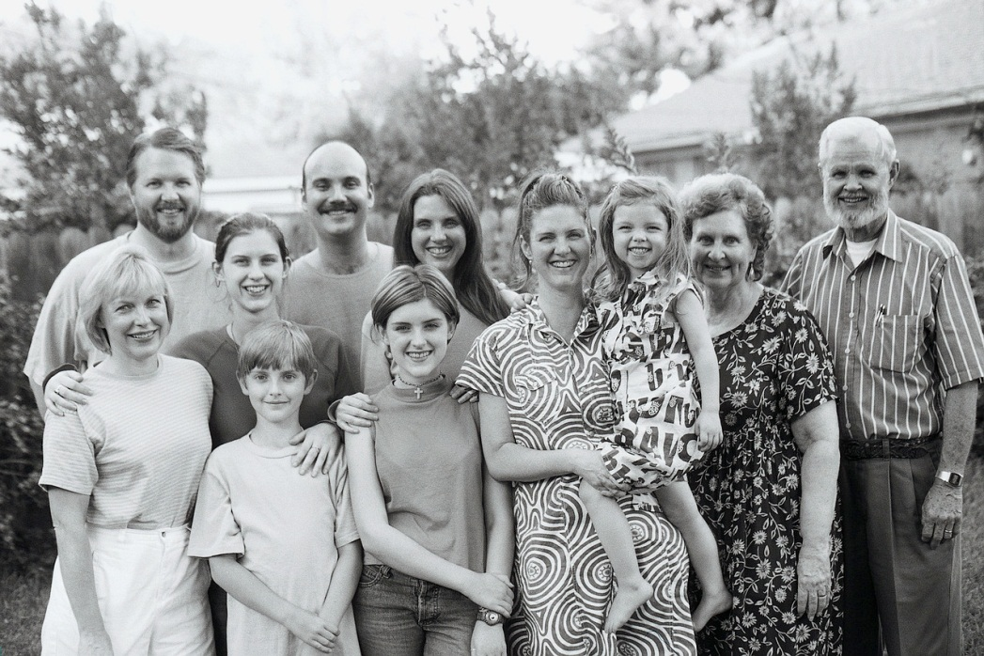
Understanding Generations
Notes:
DO: Read each question and ask any participant to share their description(s) before you shares the definitions.
SAY: “Let’s meet them” and go to the next slide.

Slide 24
What’s a Generation?
A group of people defined by age boundaries (those who were born during a certain era),
they share similar experiences growing up, and
their values and attitudes tend
to be similar.

Slide 25


What’s a Generation Gap?
A generation gap occurs when older & younger people do not understand each other because of their different values, attitudes, opinions, habits, behavior, interests, communication styles, and experiences.

Slide 26





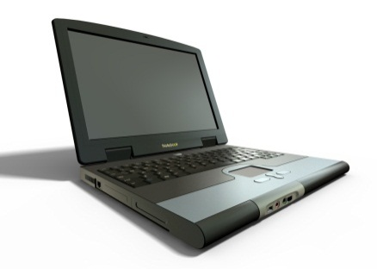
TODAY’S GENERATIONAL WORKFORCE
Pa 1.
Matures (Traditionalists) Born before 1945, they are late sixties and over today.
Baby Boomers Born 1946 to 1964, they are in their sixties, fifties today.
Generation Xers Born 1965 to 1980, they are in their late forties and late thirties today.
Millennials (Gen Y)
Born after 1980, they are early thirties and under today.
Notes:
Read slide and
SAY: “Each generation is unique. During the 1st 15-20 years of their lives, they shared a whole set of circumstances such as national events, trends, fads, music, leaders, media, which are large shapers of their personalities.”

Slide 27
GENERATIONAL MARKERS
MATURES | BABY BOOMERS | GENERATION X’ERS | GENERATION Y’ERS MILLENIALS
Great Depression Electrification World War II Cold War | Civil Rights War on Poverty Race to Space Assassinations Vietnam Impeachment | AIDS Video Games Homelessness Fall of Berlin Wall The Web | Poverty The Environment Violence Terrorism Technology School Shootings
Notes:
Read slide and
SAY: “Each generation is unique. During the 1st 15-20 years of their lives, they shared a whole set of circumstances such as national events, trends, fads, music, leaders, media, which are large shapers of their personalities.”

Slide 28
Generation Gaps
If you don’t think a generation gap makes a difference, think of this example:
How and where did Kennedy die?
Matures and Baby Boomers would say gunshots in Dallas, Texas. (currently 40+ years old)
Generation Xers remembers a plane crash near Martha’s Vineyard, Massachusetts.
(25 to 40 years old)
Millennials might say “Kennedy who?” (5 to 29 years old)

Slide 29
QUESTION: Do Workers of different generations blend as they work together?
Is age a major factor at work?
Source:HRI, 2001 Changing Workforce Survey

Slide 30
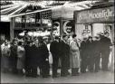

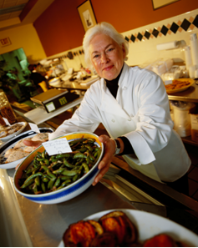
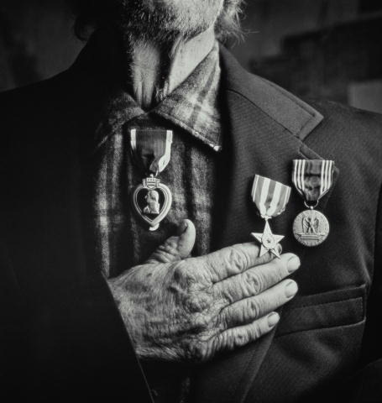
What do they value at work?
Matures
Dependability
Loyalty and tradition
Persistence
Hard Working and long hours
Work-life balance is a personal responsibility
Wisdom and experience are better than ‘book smarts’
Satisfaction of a job well done is reward enough
Don’t need feedback – no news is good news
See changing jobs as carrying a stigma
“I learned it the hard way and so will you”
Key Words: Loyal and Rational
Notes:
Read Slide:
Other notes:The United States population aged 65 and over is expected to double in size within the next 25 years. By 2030, almost 1 out of every 5 Americans -- some 72 million people -- will be 65 years or older. The age group 85 and older is now the fastest growing segment of the U.S. population.

Slide 31
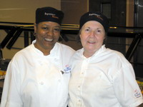


Baby Boomers
Workaholics
Accept Stress
Team – oriented
Status/Titles important
Want money, promotional opportunities
Want feedback once a year (with supporting documentation)
Want support in finding meaning and balance between work/life.
Key Words: Optimistic and Positive
Notes:
Read Slide

Slide 32


Gen-Xers, X-ers
Expect close supervision
Dedicated to goal achievement
Desire for job security ; insecure; focus on employability
Desire to be recognized; no ‘dues paying’
Freedom is the ultimate reward; “free-agent” approach.
Want immediate feedback – now
Want balance now – do not want to wait for a life
Changing jobs is seen as necessary
The more they learn, the more they will stay.
Work life/ Balance
Fun and communal workplace
Key Words: Skepticism and caution
Notes:
Read Slide
Reference Notes: Skeptical of the “establishment”
Resourceful and independent
Hate to be micro-managed
Quick to leave for another opportunity
Rewarded by flexibility in the workplace
Place a high emphasis on work / life balance; 70 percent would choose time off instead of more money and 40 percent would choose time off over a promotion
Define their work by their projects
80% of all new businesses started in the last three years belong to X-ers
Average 11 to 13 jobs per career

Slide 33
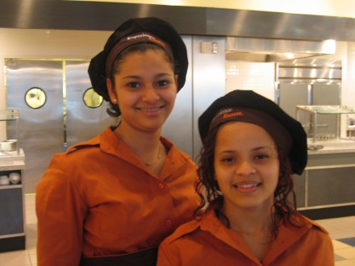

Millennials
Dependent on close supervision
Challenge and variety seeking
Distrust hierarchy and authority
Continuous development of skills
Lack of loyalty – unwilling to commit
Work/life balance
Fun and communal workplace
Want meaningful work over rewards
Want immediate feedback – yesterday
Work isn’t everything – flexibility is key
Expect to change jobs – even careers – many times
Believe that continuous learning is the way of life
No ‘dues paying’
Key Word: Realistic and Hopeful
Notes:
Other references:
Realistic, optimistic, savvy
Take a collaborative approach to work
Share their ideas with managers and colleagues to get the job done
Average 21 to 35 jobs per career
They are not looking for career paths - they are looking for life paths.

Slide 34
Workplace Characteristics
Depression
1927-1945
Baby Boom
1946-1964
Baby Bust
1965-1983
Baby Boomlet
1984-2002
Strong work ethic
Hoe to end of row
Manage
Loyal to employer
Independent but
conventional
Work well
with others
Technically
savvy
Follow the leader
Strong chain
of command
Want to win
Money/principles
Mixed
Manage (lead/follow)
Mixed
Care deeply about
what others think
Want others to work
with them
Technically
challenged
Lip service to mission
Mixed
Want to win
Principles/satisfaction
Lifestyle first
No need to lead
Loyal to skills
Don’t care what
others think
Work best alone
Technically
savvy
Care about mission
Individual first
Want to win
???
Lifestyle first
???
???
Don’t care what
others think
Work best alone
Technically
sophisticated
Must have mission
Individual first
Want to win
HRI

Slide 35
Learn the four (4) Generation Characteristics. And find ways to interact with each group that will be mutually beneficial acknowledging their differences:
 | Matures | Baby Boomers | Generation X | Millennial
Work Ethic and Values | Loyal Practical, formal Hard work Respect authority Sacrifice Duty before fun Adhere to rules | Loyal, optimistic Workaholics Work efficiently Crusading causes Personal fulfillment Desire quality Question authority Team player | Eliminate the task Self-reliance Want structure & direction Skeptical Prove it to me Informal | Goal –oriented optimisitc What’s next Multitasking No “dues paying” Entrepreneurial Tolerant Social activism
Work is … | An obligation | An exciting adventure | A difficult challenge A contract | A means to an end Fulfillment
Interactive Style | Group is more important than the individual | Team player Loves to participate in team meetings | Entrepreneur | Participative Run in packs
Feedback and Rewards | No news is good news Satisfaction in a job well done | Don’t appreciate it Money Title recognition | Sorry to interrupt, but how am I doing? Freedom is the best reward | Instant gratification Whenever I want it, at the push of a button Meaningful work
Messages That Motivate | Your experience is respected | You are valued You are needed | Do it your way Forget the rules | You will work with other bright, creative people
Work and Family Life | Work-life balance is a personal responsibility | No balance Live to work | Balance Work to live | Balance
Gen "X"
Notes:
Read Slide & cite Examples:
SAY: Managing across generations is simply understanding the differences and similarities between the generations and to try to build bridges to lessen the gaps

Slide 36
In a Nutshell…
Appreciate their strengths, values, and expectations. Instead of harbouring frustration over generation differences, focus on the positive attributes your people possess and create an environment that appeals to all.
Matures
Work hard, respect authority, follow rules, believe in paying their dues, being loyal to institutions, and the customer is always right
Boomer
Work hard and long (workaholic), work efficiently, want to be respected and rewarded, like being competitive
Xer
Work smarter-not harder, multi-tasker, work to live, don’t micromanage me, thank me often, lighten up
Millennials
Important and interesting work first, mentor me, I want goals and direction, what’s in it for me, let me have fun
Gen "X"
Notes:
Review Slide & ask participants the question at the bottom of the slide.

Slide 37
Strengths on the Job: stability, dedication and loyalty
Workplace strategies for coaching and managing Matures
DO: Ask what has worked for them in the past Acknowledge their contributions Let them define quality; focus on quality Show Respect. Appreciate their dedication. Offer opportunities for them to mentor.
DON’T: Attempt to wow them with data Force the use of technology unnecessarily
Gen "X"
Notes:
First, we are going to show respect – called deference . Give some deference to this generatio for the life threy lived and worked done. We do this by listening to them ….acknowledge By listren to their
Value of experienced workers It is an accepted truth today that our culture favors youth. But in the business world, there are many reasons for small companies to do just the opposite. Older employees offer experience, reliability, stability and wisdom. Veteran workers often have the experience to know what will work and what won’t––a skill that cannot be taught. When involved in split-second decisions, such experience can save a company time and money.

Slide 38
Strengths on the Job: teamwork and dedication-workohilic and competitive
Workplace strategies for coaching/managing Boomers
DO: Show them how you can help them use time wisely Assess their comfort level with technology in advance Acknowledge their time spent in the workplace Demonstrate the importance of a strong team Use optimistic language; Speak in an open direct style Offer meaningful work and recognition as appropriate. Follow up and check in and ask how the individual is doing on a regular basis
DON’T: Assume you understand or know their needs in advance Assume technology is the solution Assume they’ll tell you if they are struggling-you need to check in
.
Gen "X"
Notes:
Read Slide

Slide 39
Workplace strategies for coaching/managing X’ers
Strengths on the Job: adaptability and bridge-builders-cynical and pessimistic
DO: Put all the options on the table Be prepared to answer “why” Present yourself as an information provider Appear to enjoy your work Follow up and meet your commitments Give them space. Get over the notion of dues paying. Push them to keep learning.
DON’T: Try to underplay the challenge View questions as an implied challenge
Gen "X"
Notes:
Read Slide
Loyal to people, not companies.

Slide 40
Workplace strategies for coaching/managing Millennials
Strengths on the Job: team oriented and resilient-busy, stressed, ambitious
DO: Provide timely feedback. Offer peer-level examples. Spend time providing information and guidance. Be impressed with their decisions. Challenge them. Ask them their opinion. Find them a mentor. Demonstrate personal relevance
DON’T: Create a stressful environment Forget the importance of the individual
Gen "X"
Notes:
Read Slide

Slide 41
“Me” Chart
ME
Notes:
NOTE: It’s best to have this “Me Chart” as a separate handout.
Instruct participants to select ten dimensions of diversity and complete the “me” chart. They are to give specific information about themselves. They will be sharing this information with the group.

Slide 42

Exclusion not including anyone/anything that is “different” using “..isms” as barriers to acceptance: racism, ageism, sexism, elitism,

Slide 43
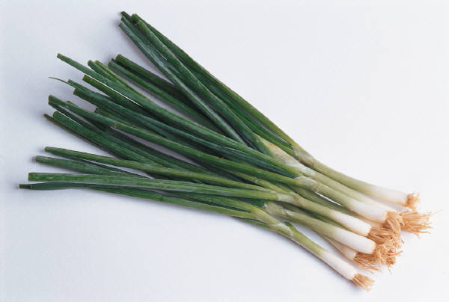




Diversity presence of differences that can be used to differentiate groups from one another

Slide 44

Inclusion
Recognizing
that we are
one even
though we
are not
the same

Slide 45


Through inclusion we have a blend of flavor

